Slide 1


FinExplain
Evidence-first AI for loan decisions
Understand the fine print before it costs you.
Team Name: CodeFlex
Team Members: Samadhan Mane
Sakshi Bhingarkar
Pranav Karande
FOCUS
Borrowers comparing personal loans and trying to understand real cost before committing.
Built for inspectable decisions
Official loan documents · Plain-language explanations · Evidence-linked answers

Slide 2

THE PROBLEM: BORROWERS SEE THE RATE, BUT NOT THE FULL DECISION
PROBLEM STATEMENT
When comparing loans, borrowers often see a headline APR but must manually find fees, penalties, eligibility rules and repayment conditions across multiple documents to determine the actual cost for their situation.
The first user is not “everyone.” It is a borrower who needs a decision, not a document summary.
A FICTIONAL LOAN COMPARISON
01
Headline claims are easy to compare; the conditions that determine actual cost are not.
Primary user: a financially inexperienced consumer comparing a loan and planning to repay early.
02
The user must search manually, interpret terminology, compare clauses, and calculate consequences.
Product A
Product B
03
FinExplain is designed to make that chain inspectable before the commitment.
10.5%
11.2%
HEADLINE APR
HEADLINE APR
59%
+ 2% processing fee
+ $2,000 fixed fee
had a major unexpected expense in the prior 12 months.
+ possible early-repayment charge
+ no fee after stated period
16%
did not pay all bills in the prior month.
63%
could cover a hypothetical $400 emergency with cash or its equivalent.
What looks cheaper at first glance can change after fees + conditions + timing are included.
[1] Federal Reserve, SHED 2025, released May 2026. .

Slide 3
WHY THIS MATTERS FOR LOAN DECISIONS
The real challenge isn't finding information.
It's understanding what it means for the decision.
Information exists. The missing layer is connecting scattered loan clauses to one borrower scenario with evidence, calculations and clear uncertainty.
THE GAP
01
Find
Important terms are spread across rates, fee schedules,
eligibility rules and repayment conditions.
02
Understand
Financial terminology and exceptions are
difficult to interpret quickly.
Compare
2024 NFCS knowledge indicators
03
Users must connect those clauses and calculate how
they affect their specific situation.
Answered ≥5 of 7 knowledge questions
27%
Answered inflation question correctly
58%
Fin-Explain turns this scattered information into an
evidence backed decision journey.
Age 18–34: inflation question
44%
[2] FINRA Foundation / FINRA, 2024 NFCS findings, released April 2025.
[2] FINRA Foundation / FINRA, 2024 NFCS findings, released April 2025

Slide 4

THE GAP FINEXPLAIN ADDRESSES
The fine print is distributed across documents not decisions
From headline claim to verifiable choice
THE GAP FINEXPLAIN ADDRESSES
1
Headline claim
A short advertisement foregrounds an attractive rate, reward, or “low-cost” promise.
01
Headline rates are easy to compare.
Actual cost is not
10.5% APR
“Low fee”
02
Users must manually find, interpret and connect
clauses across documents.
2
Distributed fine print
Fees, exceptions, late-payment rules, eligibility, and early-repayment conditions sit across schedules and terms.
03
Missing or conflicting information should
be exposed, not guessed.
Fee schedule
Section 8
Eligibility rule
FinExplain connects scattered loan evidence into an inspectable decision.
3
Verifiable choice
The user needs an explanation that connects the decision to exact clauses, dates, and uncertainty.
What the document says
What to verify

Slide 5

PROPOSED SOLUTION: TURN LOAN DOCUMENTS INTO A TRANSPARENT DECISION
SOLUTION
Upload official loan documents → retrieve relevant clauses → compare terms → calculate scenario cost → explain in plain language → verify every material claim.
Every answer separates meaning from evidence
A DECISION JOURNEY GROUNDED IN SOURCE DOCUMENTS
01
02
03
PLAIN-LANGUAGE EXPLANATION
The assistant translates complex terms without removing qualifications or exceptions.
Ask
Compare
Verify
Select one or more products, upload documents, and ask about fees, penalties, eligibility, or repayment.
See important terms side by side, including headline rates, conditions, exclusions, and potential cost drivers.
Open the exact source section, page, and retrieved passage supporting each material claim.
STRUCTURED COMPARISON
Rates, fees, repayment conditions, and eligibility appear in a consistent format.
UNCERTAINTY BEHAVIOR
Example question: “Which conditions could make this product more expensive?”
Not specified when the available documents do not contain the requested detail.
KEY FEATURES
Evidence-linked answers · Structured loan comparison · Scenario cost calculation · Missing-info flags · Conflict detection

Slide 6

TECHNOLOGY STACK
One category, one auditable journey
TECH STACK
Technical stack to finalize
Start with personal loans or credit cards, where rates, hidden fees, and repayment conditions directly affect consumer decisions.
Frontend: React.js · Tailwind CSS · React Router · Axios
Backend: Node.js · Express.js · REST APIs · JWT · bcrypt
AI/RAG: Python · LangChain · RAG · Agents · Custom Tools
LLM: Groq API · Llama-based LLM
Embeddings: Hugging Face · all-MiniLM-L6-v2
Retrieval: Vector Search · Reranking
Databases: PostgreSql · Pinecone
Document Processing: PyMuPDF · Chunking · Metadata Extraction
Core AI Tools: Financial Calculator · Comparison Engine · Evidence Verifier
Primary user: financially inexperienced consumers comparing loans or credit cards who need a clear answer before committing.
Frontend
Backend
Upload, questions, comparison,
API orchestration and structured
citations
responses
Document processing
Retrieval
PDF parser / OCR / section-aware
Embeddings + vector index +
01 · SCOPE
02 · PROVE
03 · MEASURE
chunking
keyword search
Personal loans
Compare + scenario-test
Verify + evaluate
Reranking
Calculation
Ingest two or three product document sets with dates and source metadata.
Question/product/date-aware clause
Deterministic cost and scenario
Answer the $20,000 / six-month question with structured comparison and calculation.
Test citation coverage, missing information, conflicts, and unsupported claims.
ranking
engine
Generation
Verification
LLM explanation with citations
Claim entailment + conflict +
Upload + parse PDFs
missing-info flags
Preserve sections and pages
Side-by-side cost drivers
Claim → evidence checks
Future expansion: after loans, we will extend the same evidence-first layer to insurance, mortgages, and other document-heavy products.
Visible calculation inputs
Known-answer evaluation
Document
→
Retrieve
→
Calculate
→
Explain
→
Verify
Roadmap · Scalability

Slide 7
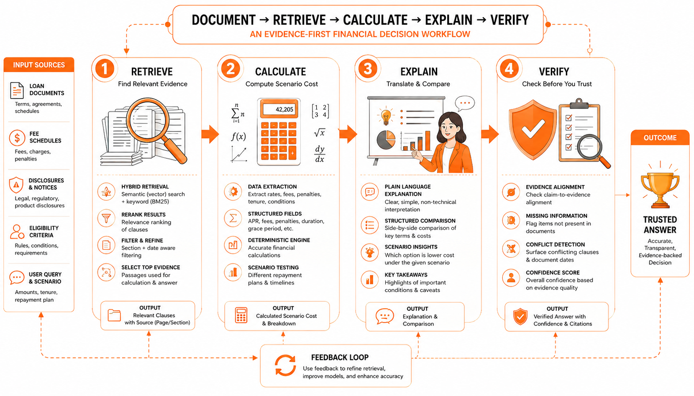
TECHNICAL ARCHITECTURE: EVIDENCE-FIRST LOAN DECISION WORKFLOW
Architecture diagram:
https://drive.google.com/drive/folders/1JN6wZugSDvhiz22m5gX8ZQLGw6gmLWDg?usp=sharing

Slide 8

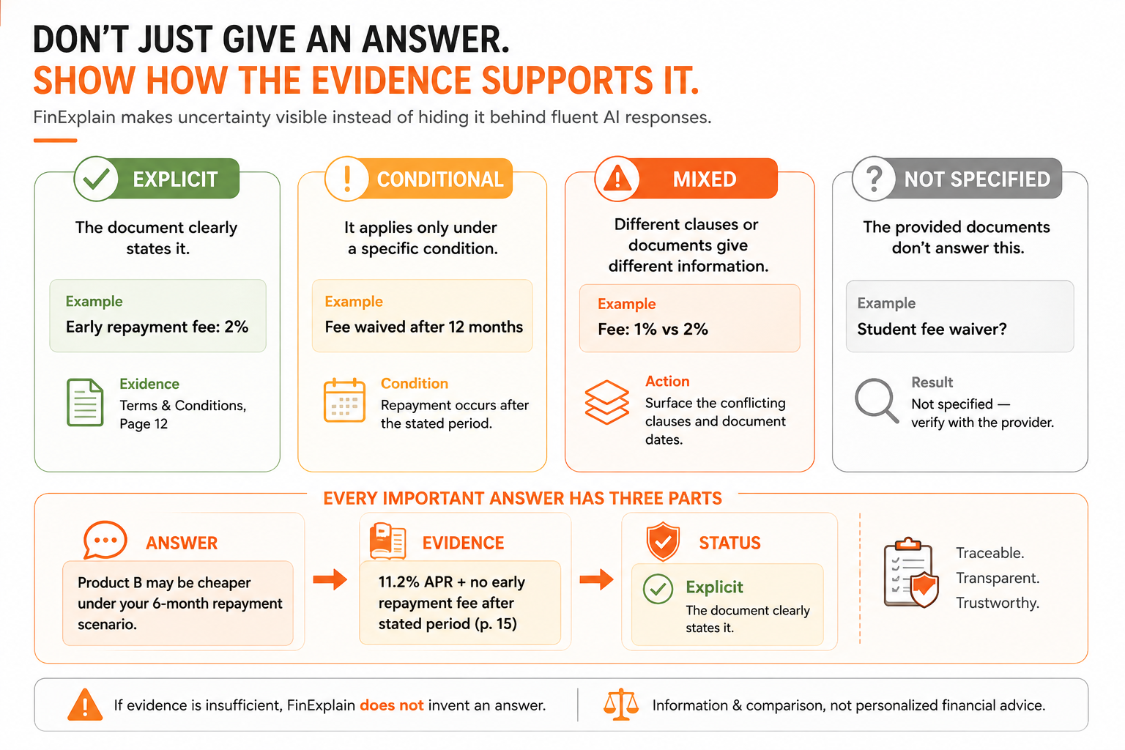
TRUST IS A PRODUCT FEATURE, NOT A DISCLAIMER
A fluent answer is not enough. The user must be able to inspect the claim.
Every answer carries an evidence status
The interface separates what the document says from what the system infers or cannot verify.
MISSING-INFORMATION EXAMPLE
Question: Is the fee waived for students?
Not specified.
No supporting clause found. Verify the current official terms.
CONFLICT-DETECTION EXAMPLE
2025 terms: fee = 3% · 2026 terms: fee = 1%
Conflict detected.
Show both clauses, their dates, and which document is latest.
Evidence status is part of the answer format, not a post-hoc disclaimer.
FinExplain explains what the document says, what it means, what is unclear, and what to verify. It does not provide personalized financial advice.
Every important answer has three parts:
ANSWER → EVIDENCE → STATUS

Slide 9

KILLER EXAMPLE: WHICH LOAN IS ACTUALLY CHEAPER?
A higher APR can still be the lower-cost choice
A scenario-based comparison reveals what the headline rate hides.
FinExplain makes the decision traceable for a borrower not just fluent.
01 · RETRIEVE
Find the cost drivers
“I need a $20,000 loan and expect to repay it in six months. Which product is cheaper?”
Retrieve APR, duration, processing fee, early-repayment fee, late fee, and any reductions from the source clauses.
Field
Product A
Product B
Status
02 · CALCULATE
Headline APR
10.5%
11.2%
Explicit
Compute outside the LLM
Total cost = principal + interest + fees + penalties − reductions
Processing fee
2% of approved amount
Fixed fee of €2,000
Explicit
Early repayment
Charge may apply
before stated period
No fee after stated period
Conditional
The calculation engine uses structured inputs and the borrower’s six-month scenario.
Late-payment charge
Specified in Section 8
Not clearly stated
Mixed
03 · EXPLAIN
Initial signal
Lower rate
Higher rate
Incomplete
Return a qualified conclusion
“Product B may have lower total cost under this repayment scenario.” Show the exact evidence behind the claim.
Principal
Duration
Interest
Fees
Penalties
$20,000
6 months
Retrieve
Retrieve
Scenario-test
04 · FLAG
The final answer should expose the inputs and calculation path; it should not let the LLM invent a total.
No silent guessing
Qualified conclusion + calculation inputs + exact evidence + any missing information
“Not specified.”
DECISION OUTPUT
If a fee waiver or condition is absent, identify the gap and tell the user what to verify.

Slide 10

UNIQUENESS + COMPETITIVE ADVANTAGE
Why FinExplain is more than a financial document chatbot
FinExplain is a financial decision layer, not simply a document summarizer.
RAG enables the system. The evidence-first workflow is the product.
Capability comparison
Capability
Generic AI
FinExplain
PDF Q&A
Available
Yes
1 · Compare, don’t just summarize
Summarization
Available
Yes
Normalize rates, fees, repayment rules, exclusions, and eligibility into a decision-ready view.
Structured cost comparison
General Purpose
Core flow
Scenario testing
General Purpose
Core flow
2 · Calculate, don’t improvise
Evidence status
May vary
Explicit
Use structured inputs and a deterministic cost engine before asking the LLM to explain.
Missing information
May guess
Flagged
Conflict detection
Not default
Surfaced
3 · Know when not to answer
Return “Not specified” or “Conflict detected” when the evidence does not support a safe conclusion.
Source traceability
varies
Document / page / passage
Not just RAG or PDF Q&A: FinExplain combines evidence retrieval, deterministic loan-cost calculation, explicit uncertainty and claim-level verification into one decision workflow.
WHAT IS UNIQUE?
Source: Federal Reserve, SHED 2025, May 2026.
Source: FINRA Foundation, NFCS 2024, April 2025.
Source: CFPB, Consumer Credit Card Market Report 2025, December 2025.

Slide 11

BENCHMARK RESULT · WHAT THE SYSTEM CAN PROVE
RESULTS: EVIDENCE QUALITY IS PRODUCTION-READY
FinExplain answers are grounded, mathematically consistent, and auditable across five operative credit agreements.
MEASURED EVIDENCE QUALITY
PRODUCTION BENCHMARK STATUS
100.0%
Faithfulness
25/25 verified answers; no unsupported dollar amounts, dates, or rates.
TARGET PERFORMANCE
18
100.0%
Arithmetic consistency
Dedicated calculation engine matched the source tables.
of 21 metrics met or exceeded target
90.7%
Citation accuracy
Document, page, and section references mapped to verified chunks.
0 critical blockers recorded. The result is not merely fluent Q&A: the system separates answer, evidence, and status.
81.7%
Claim citation coverage
Traceable factual claims; up from 53.2% in the benchmark.
88.5%
Requirement recall
Multi-part questions and contractual qualifiers preserved.
Why this matters
Traceable decision path — inspect the clause and calculation behind a number.
Auditable answer format — evidence status is visible instead of implied.
Grounded generation paired with deterministic arithmetic: the LLM explains a verified result instead of inventing one.
11

Slide 12
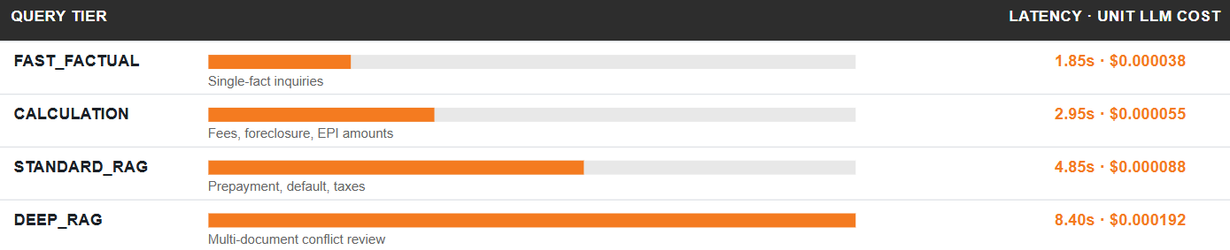
PRODUCTION PROFILE · PERFORMANCE WITH GUARDRAILS
RESULTS: FAST, LOW-COST, AND SAFE TO OPERATE
The system keeps the expensive step—the explanation—bounded, while deterministic checks make the result auditable.
FULL VERIFICATION PIPELINE
WHAT DRIVES THE RESULT
Operational performance in one view
Parallel retrieval
Vector search and BM25 execute concurrently, keeping retrieval under 25ms.
4.95s
10.53s
Bounded context
Clause-level context is capped at ≤ 2,000 tokens before generation.
P50 MEDIAN
P95 TAIL
Deterministic verification
Claim checks, evidence scoring, citation mapping, and arithmetic sit outside the LLM.
Across 25 complex test queries.
Complex queries with completeness retry.
Human escalation
Evidence score below 70% routes the response to compliance review.
TIERED PROCESSING PROFILE · MEASURED P50
PRODUCTION SIGNALS
QUERY TIER
LATENCY · UNIT LLM COST
Fast enough to use. Guarded enough to trust.
~$0.000085 Operational cost per full-credit query.
<15ms Repeated-query cache-hit path.
3 metrics Remain under operational monitoring.
HONEST PRODUCTION CAVEAT · Tail latency, cross-reference mapping, and table alignment remain under monitoring. The claim is measurably production-ready—not finished by assertion.
Operational LLM cost is approximately $0.000085 per full-credit query; repeated questions can use the <15ms cache-hit path.
12

